Slide 1
Crime and Dine
Rachel Berkowitz, Jeanette Cross, Michael Lygas, Xeniya Bogoslavskaya

Slide 2
In January, a resident of Ohio punched through the drive through window in MacDonald’s when she was told they don’t serve chicken McNuggets early in the morning.
A male in Los Angeles hit the female in the face when she started complaining about him cutting the line.
Just recently another accident happened in California when a male verbally assaulted the cashier because she didn’t wish him to have a good day.
The list goes on…

Slide 3
U.S. Bureau of Labor Statistics reported that the crime in a neighborhood with a low rated restaurant has decreased from 35% to 15%.
The Media tends to think that there is definitely more crime happening in locations with low rated restaurants. We wanted to see for ourselves if it true and if so to which degree.

Slide 4
Motivation & Hypothesis
Comparing the restaurant ratings to the US crime statistics.
We expect there not to be a correlation between the restaurant ratings and the crime statistics because there are often good eateries in bad areas.

Slide 5
Research Questions
1
Does the number of high rated restaurants in a given area correlate to the number of crimes in the area?
2
How does it differ by different types of crimes?
3
Will a dining establishment Yelp review be impacted by population metrics (i.e. a more populous area have a higher rating)?

Slide 6
Data sources
Crime data: Data.gov
An annual publication in which the FBI compiles the volume and rate of violent and property crime offenses for the nation and by state. Individual law enforcement agency data are also provided for those contributors supplying 12 months complete offense data.
Format : .csv file
https://catalog.data.gov/dataset/crime-in-the-united-states-2015

Slide 7
Data sources
Restaurant rating: Yelp.com
API: https://api.yelp.com/v3/businesses/search
Yelp documentation: https://www.yelp.com/developers/documentation/v3/business_search
Format: json
https://www.kaggle.com/uciml/restaurant-data-with-consumer-ratings - Reviewed and discarded since we were not sure about the reliability of the source. The volume did not meet the 10,000’s criteria

Slide 8
Process
Clean_crime_data.ipynb – Load crime data from data.gov
Yelp.ipynb – call Yelp API and write yelp_data.csv file
Reformat_yelp.ipny – Split county and state into separate columns and write yelp_reformat.csv
ANALYSIS01.ipynb – Analyze the data using graphs
Heatmap.ipynb – Generate heat maps
Statistics.ipynb – Statistical analysis to confirm analysis

Slide 9
Data volume
Crime data:
3,137 Counties
Yelp data:
105,640 restaurant ratings
Accessed ratings for up to 50 restaurants per county
27 counties had no restaurant ratings
Process took about 1 hour to extract data

Slide 10
Loading Crime Data

Slide 11
We found Crime data and started to prepare crime information. First we needed to clean the data. So we listed all the columns to determine which ones we need.
Created a new DataFrame, dropped the columns we won’t use and renamed the columns for cleaner look and finally converted it to csv file for further use.

Slide 12
Loading Restaurant Rating

Slide 13
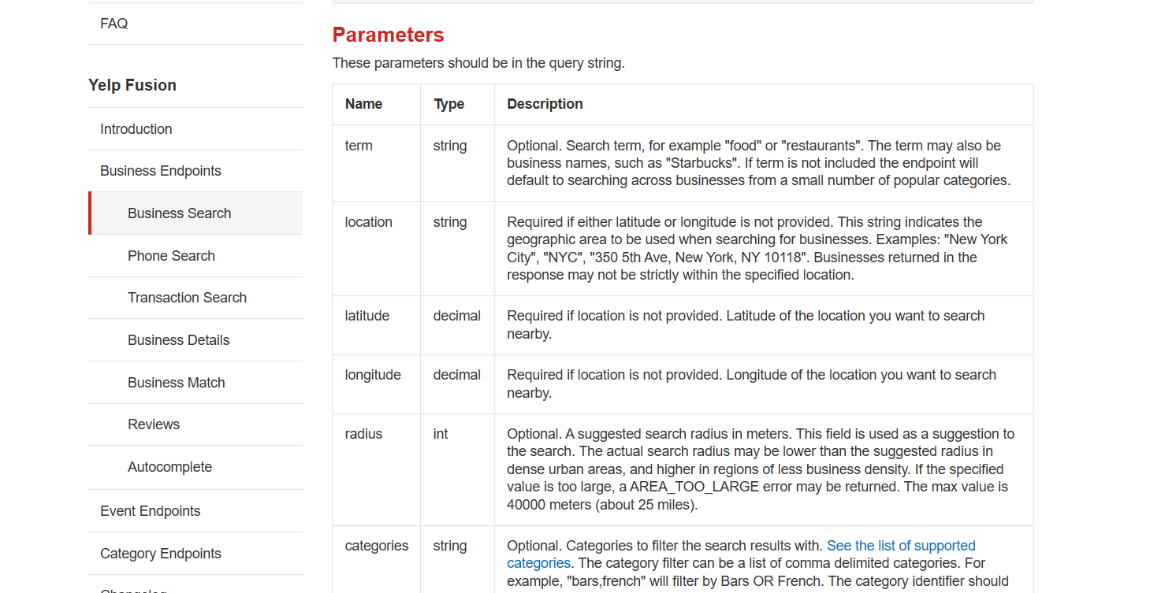
Yelp Documentation

Slide 14
Set up Yelp URL headers for API calls
Loop through each county and retrieve 50 restaurants
Check for errors or missing values
Added empty columns to capture the data we have received from crime doc
Write to CSV File

Slide 15
Lessons Learned
Crime data
Data included counties and parishes
Yelp data
5,000 limit per day
Concatenate cities when executing API to reduce calls to API
Job failed after executing for 45 minutes
Add code to display start and end time when testing for smaller volume to estimate larger tests
Add check points to restart code at failure point.

Slide 16
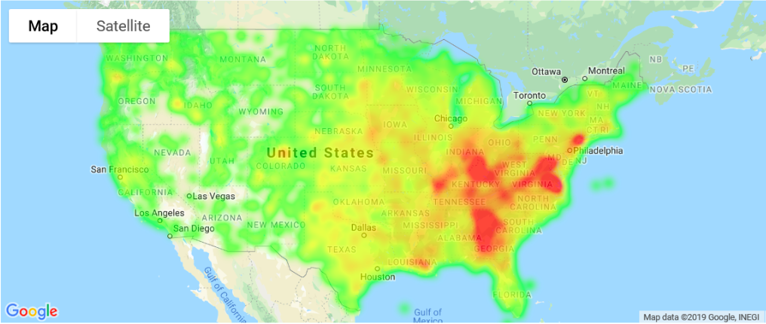
Restaurant Ratings

Slide 17
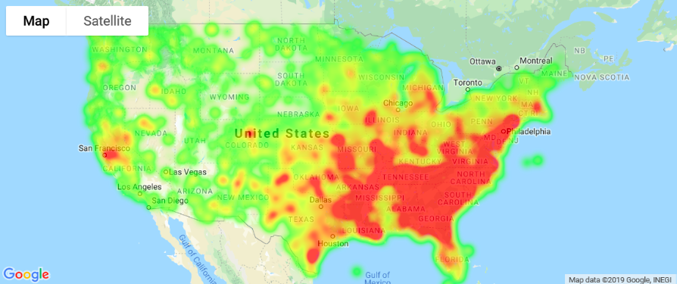
Crime Rate Heatmap

Slide 18
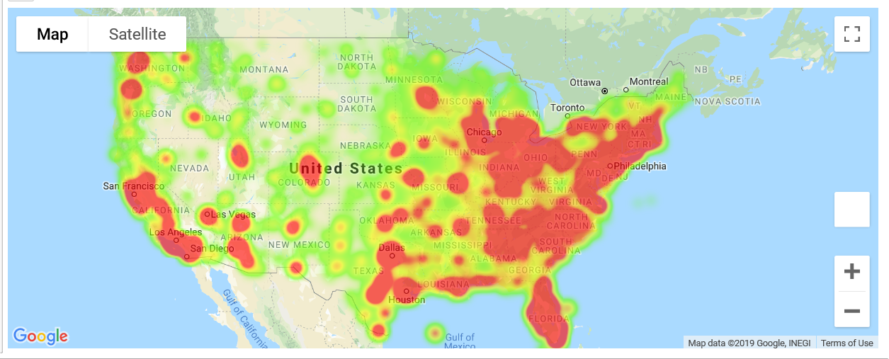
Population Heatmap

Slide 19
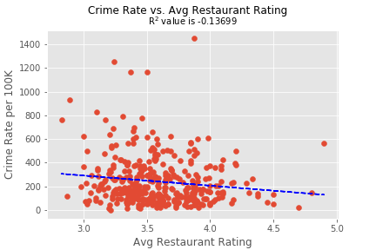
Check for Correlation between Crime (Type of Crime across US) data & Dine (Yelp Review data)

Slide 20
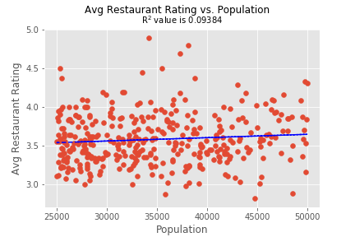
Check for Correlation between Yelp Restaurant Rating and Population

Slide 21
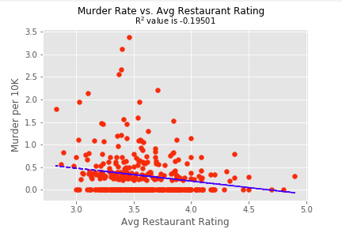
Check for Correlation between Murder and Yelp Avg Restaurant Rating

Slide 22
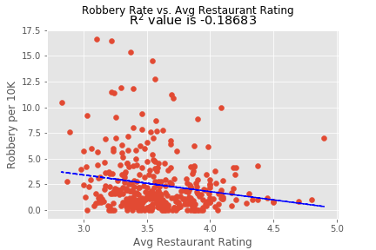
Check for Correlation between Robbery Rate and Yelp Avg Restaurant Rating

Slide 23
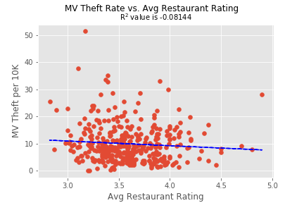
Check for Correlation between MV Theft Rate and Yelp Avg Restaurant Rating

Slide 24
Is the Average Restaurant Rating per County Correlated by the Number of Crimes?
Let’s look at it statistically!
Skip to the Conclusion

Slide 25
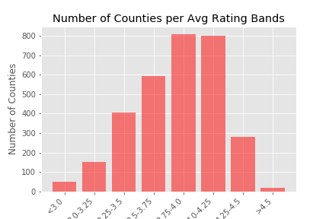
Separate the Avg Restaurant Rating into Groups
First we separated the average restaurant rating into categories from 3 – 4.5 separated by .25 buckets using binning.
Here is the distribution of the number of counties per average rating block:

Slide 26
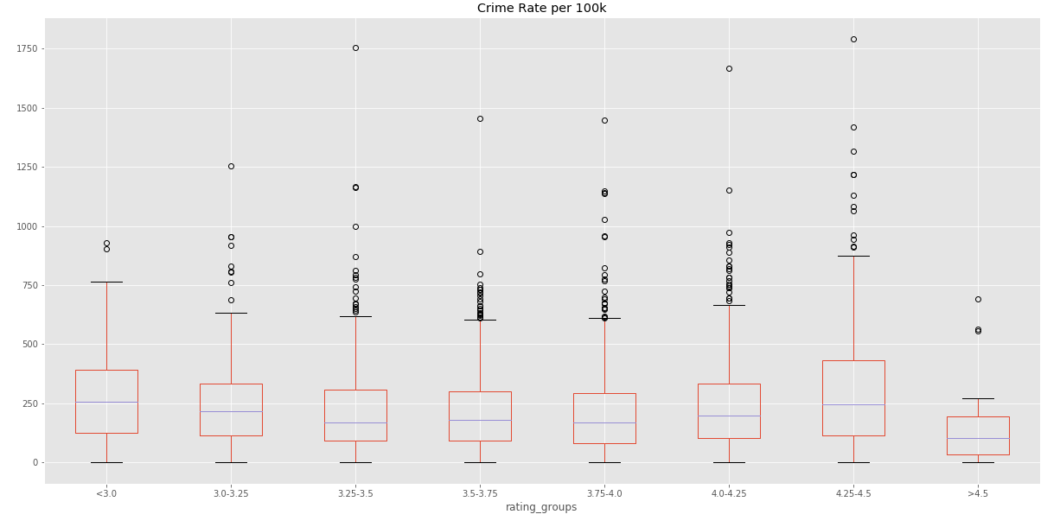
Using ANOVA To Evaluate if the Avg. Rating is Correlated to the Crime Rate
Null Hypothesis:
If the p-value is greater than 0.05 then we would accept the null hypotheses that the differences in the groups in based on random chance.
Looking at the box plots some look similar and others different.
Using ANOVA the p-value of all the groups are 1.4435597466334614e-12 which indicates that the differences are not due to chance (reject the null hypothesis).
Given a p-value of 0.274 for the ranges <3.0 and 3-3.25 we choose to accept the null hypothesis and assume they are similar.
Given a p-value of 0.204 for the 3.25-3.5, 3.5-3.75, and 3.75-4.0 we choose to accept the null hypothesis and assume they are similar

Slide 27
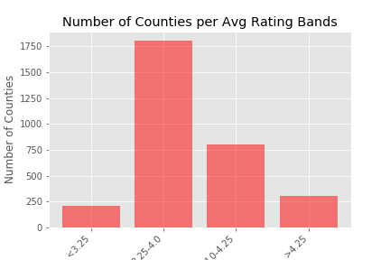
Separate the Average Restaurant Rating into Similar Groups
Next we re-binned the data into groups that were statistically similar:
Less than 3.25
3.25 to 4.0
4.0 to 4.25
Greater than 4.25
Here is the distribution of the number of counties per new average rating block:

Slide 28
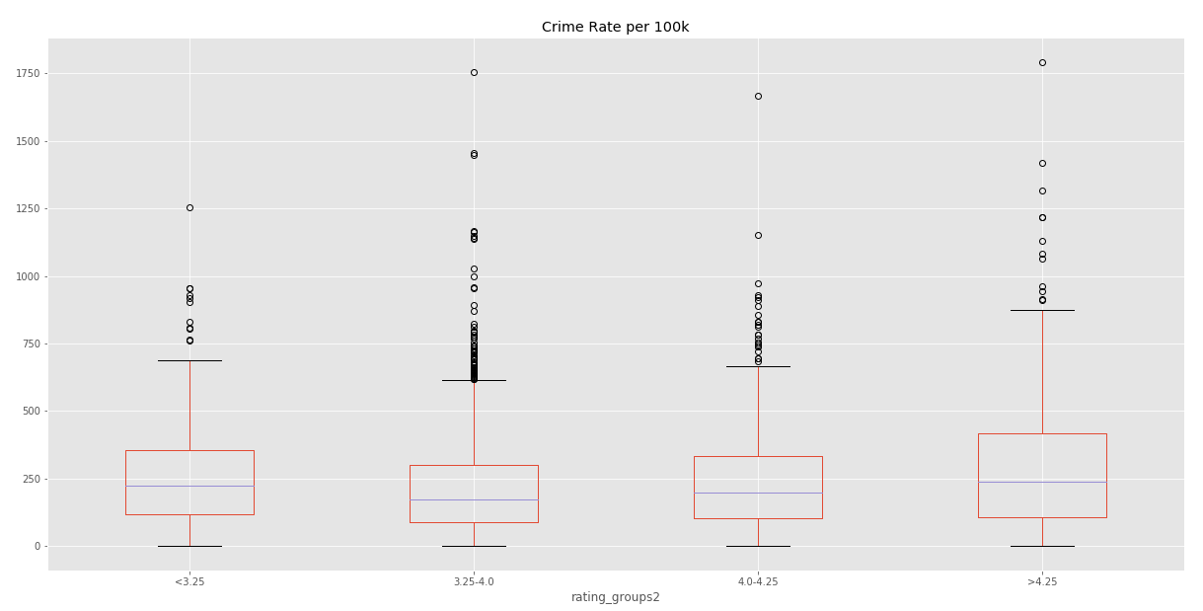
Using ANOVA To Evaluate if the Avg. Rating is Correlated to the Crime Rate
Null Hypothesis:
If the p-value is greater than 0.05 then we would accept the null hypotheses that the differences in the groups in based on random chance.
The medians start higher, go lower and then go up again.
Using ANOVA the p-value of all the groups are 3.491699496728524e-12 which indicates that the differences are not due to chance (reject the null hypothesis).
We can say that statistically there is a correlation between the average rating and the rate of crime!

Slide 29
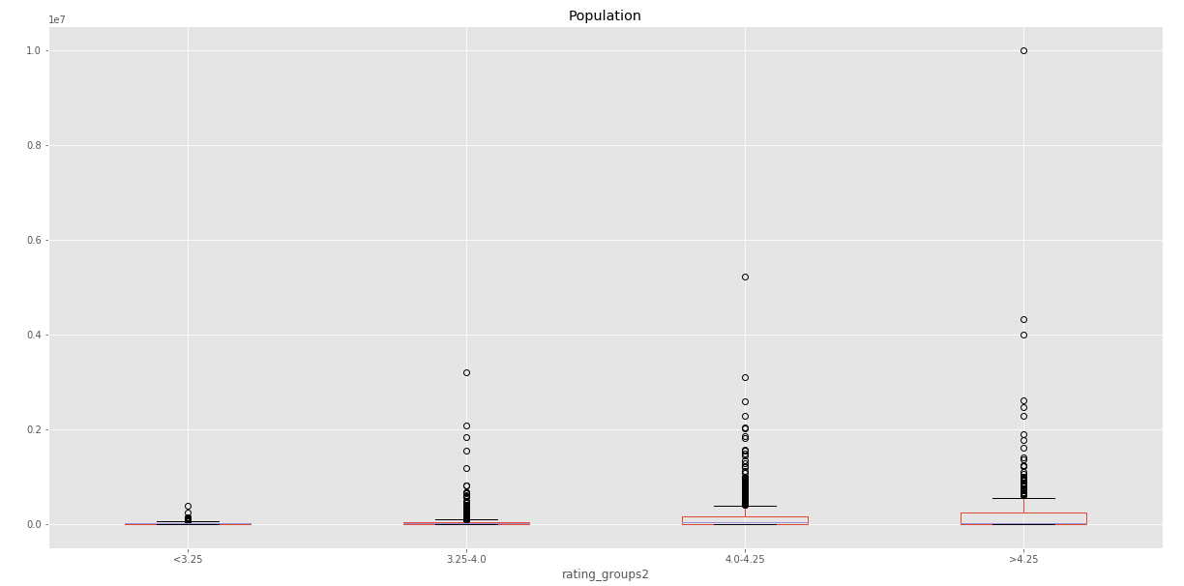
Using ANOVA To Evaluate if the Avg. Rating is Correlated to the Population
Null Hypothesis:
If the p-value is greater than 0.05 then we would accept the null hypotheses that the differences in the groups in based on random chance.
We also took a quick look at how the average restaurant rating correlates to population size.
The p-value is 3.467951378204408e-38 which indicates that the differences are not due to chance (reject the null hypothesis).
We can say that statistically there is a correlation between the average rating and the population!

Slide 30
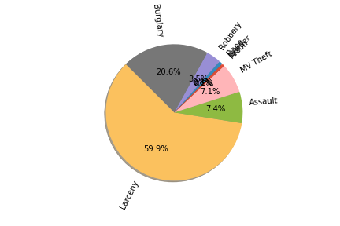
Does the type of crime differ?
With a degree of freedom of 7 (there are 8 types of crimes), and a p value of 0.5 there is a critical value of 14.07 and a Chai squared of 23,109,324
So we reject the null hypothesis that the types of crimes are random.
Yes! We are 95% confident that they are statistically different

Slide 31
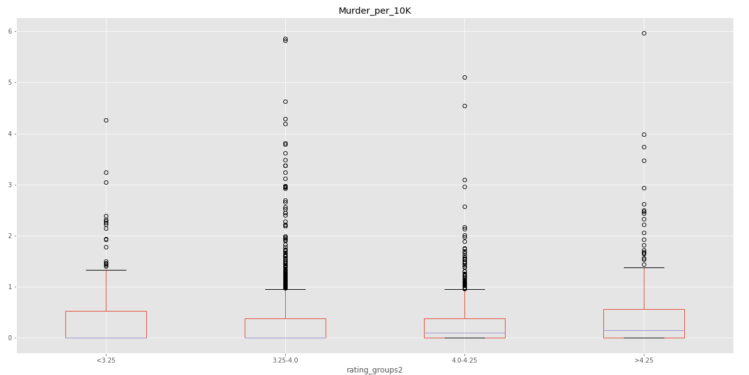
Using ANOVA To Evaluate if the Avg. Rating is Correlated to the Murder Rate
Null Hypothesis:
If the p-value is greater than 0.05 then we would accept the null hypotheses that the differences in the groups in based on random chance.
The higher the avg rating, the higher the median murder rate.
Using ANOVA the p-value of all the groups are 9.556103648099141e-06 which indicates that the differences are not due to chance (reject the null).
We can say that statistically there is a correlation between the average rating and the murder rate!

Slide 32
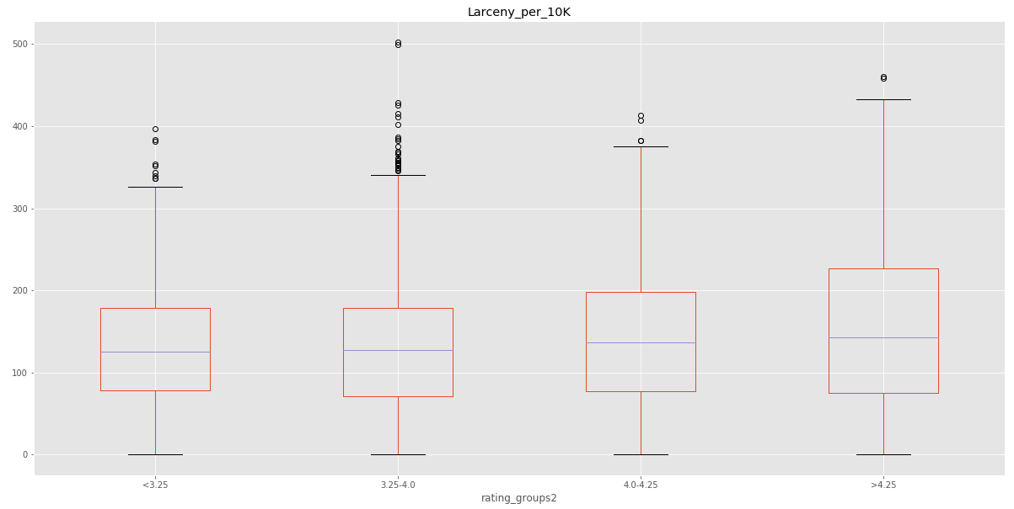
Using ANOVA To Evaluate if the Avg. Rating is Correlated to the Larceny Rate
The higher the avg rating, the higher the median larceny rate and larger the 25-75% range
Null Hypothesis:
If the p-value is greater than 0.05 then we would accept the null hypotheses that the differences in the groups in based on random chance.
Using ANOVA the p-value of all the groups are 4.6858070950656695e-48 which indicates that the differences are not due to chance (reject the null).
We can say that statistically there is a correlation between the average rating and the larceny rate!

Slide 33
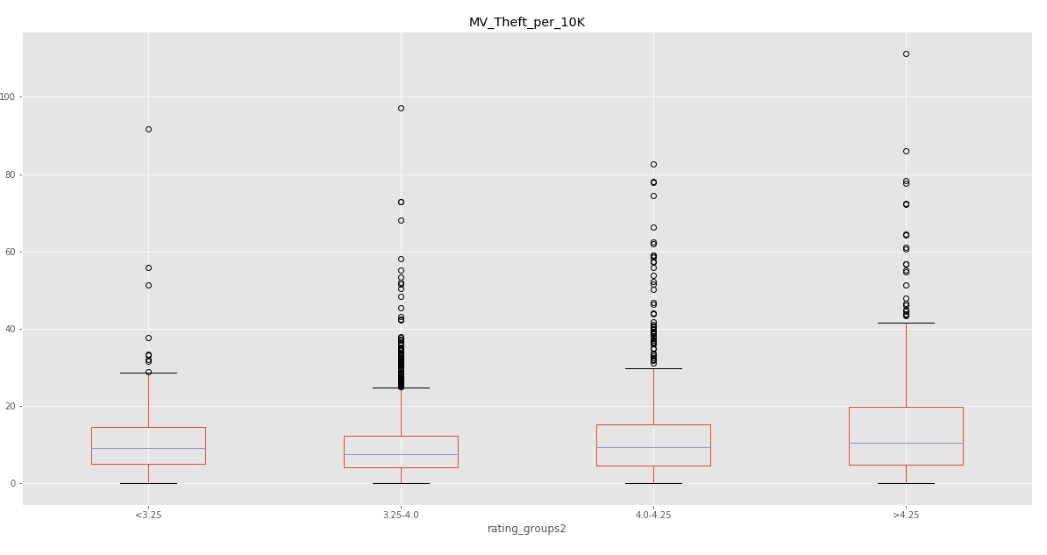
Using ANOVA To Evaluate if the Avg. Rating is Correlated to the Motor Vehicle Theft Rate
The higher the avg rating, the higher the median MV theft rate and larger the 25-75% range
Null Hypothesis:
If the p-value is greater than 0.05 then we would accept the null hypotheses that the differences in the groups in based on random chance.
Using ANOVA the p-value of all the groups are 1.838260587168992e-23 which indicates that the differences are not due to chance (reject the null).
We can say that statistically there is a correlation between the average rating and the motor vehicle theft rate!

Slide 34
Conclusions

Slide 35
Research Questions & Answers
1
Does the number of high rated restaurants in a given area correlate to the number of crimes in the area?
While there isn’t a linear correlation, using ANOVA we can see that the two are correlated.
2
How does it differ by different types of crimes?
Different types of crimes (such as murder, MV theft, and larceny) are also not linearly correlated but using ANOVA we can see that different avg. ratings do correlate with different crime rates.
3
Will a dining establishment Yelp review be impacted by population metrics (ie a more populous area have a higher rating)?
Population is correlated to the avg. rating but it may not be a linear correlation and there are many outliers.

Slide 36
Final Thoughts
Most surprisingly: Using the boxplots it appears that for many crimes, the higher the rating, the higher the median crime rate!
Causation vs. Correlations: This of course in no way implies causation and there may be other factors not contemplated by this analysis that may be affecting the rates.
Further analysis: If we had time for further analysis, we would like to bring in items like income levels for each county to see if there are any further correlations.

Slide 37
Any Questions?

